Slide 1
The Concept of Life
Unit I

Slide 2
I. Biology : The Study of Life
“What is life?”
“How is Life Defined?” : Scientific Definition
Scientists have not derived an adequate definition for Life.
A generalized definition of life is the following: “Life is a continuous series of inter-related chemical reactions that require a source of energy from the environment”.
According to scientists, all living things carry out eight essential life functions. Collectively, the eight life functions are known as metabolism.
Life is defined by an organisms ability to carry out the metabolic functions.

Slide 3
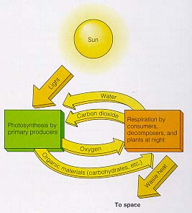

b) Metabolism: The Life Functions
Nutrition: the process in which food (organic molecules) is absorbed (ingestion) and used or broken down (digestion).
Examples:
Autotrophic Nutrition: the type of nutrition in which organisms have the ability to produce their own food by photosynthesis or chemosynthesis. Autotrophs (producers) include plants, algae, and some monerans.
Photosynthesis
From: http://www.cyber-sisters.org/home/webdestinations.htm

Slide 4
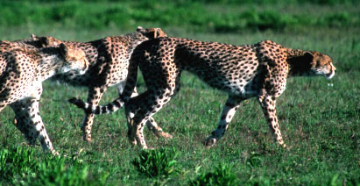
Heterotrophic Nutrition: the type of nutrition in which organisms must obtain food from their environment. Heterotrophs that consume plant material are called herbivores. Heterotrophs that consume animal material are called carnivores.
From:http://www.physicalgeography.net/fundamentals/9k.html

Slide 5
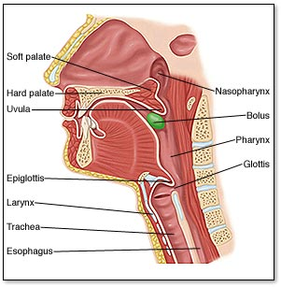
Types of Digestion:
Physical (Mechanical) – digestion by chewing, grinding, and tearing.
From:http://www.mhhe.com/biosci/esp/2001_saladin/folder_structure/ab/m4/s3/abm4s3_1.htm
Chemical – digestion by the action of acids, bases, and enzymes.

Slide 6
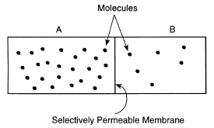
2. Transport: the process in which material is moved from one place to another (circulated) within organisms.
  Active Transport: the type of transport that moves material from a low to high concentration while using energy (ATP).
  Passive Transport: the type of transport that moves material from a high to low concentration without using energy (ATP).
Passive Transport
Active Transport

Slide 7
3. Respiration: the process in which energy (ATP) is released from organic molecules (food) when bonds are broken.
  Aerobic Respiration: the type of respiration that needs oxygen. Most complex organisms carry out aerobic respiration.
  Ananerobic Respiration: the type of respiration that does not need oxygen. Most simple organisms carry out aerobic respiration.
enzymes
C₆H₁₂O₆ + 6O₂ 6CO₂ + 6H₂O + ATP
Glucose (sugar)
oxygen
Carbon dioxide
water
energy
Aerobic Cellular Respiration
NOTE: Cellular Respiration is not the same as breathing. Breathing is a process in Physical Respiration.

Slide 8
4. Excretion: the process in which metabolic wastes (water, salts, urea, carbon dioxide) are removed from organisms.
Metabolic wastes are produced as a result of the life functions.
They must be removed from organisms because they are toxic. If allowed to accumulate, these wastes could disrupt equilibrium.
METABOLIC WASTE | A BY-PRODUCT OF ....
water | dehydration synthesis & respiration
carbon dioxide | cellular respiration
salts | neutralization
urea | protein metabolism, deamination

Slide 9
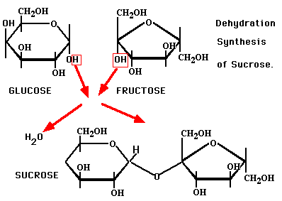
CHEMICAL REACTIONS THAT RESULT IN THE PRODUCTION OF METABOLIC WASTES
Dehydration synthesis = reactions in which small molecules are combined to form large molecules. Water is a metabolic waste produced from this reaction.
From: http://staff.jccc.net/pdecell/biochemistry/sucrosesyn.gif

Slide 10

Cellular respiration = chemical reaction that releases energy from organic molecules (usually glucose).
C₆H₁₂O₆ + 6O₂ 6CO₂ + 6H₂O + ATP
Water and carbon dioxide are the metabolic wastes that is produced by Cellular respiration.
Neutralization = reactions between acids & bases.
Acid Base salt water
Water and salt are the metabolic wastes that are produced by Neutralization.

Slide 11
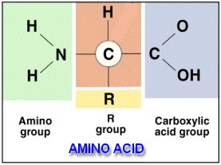
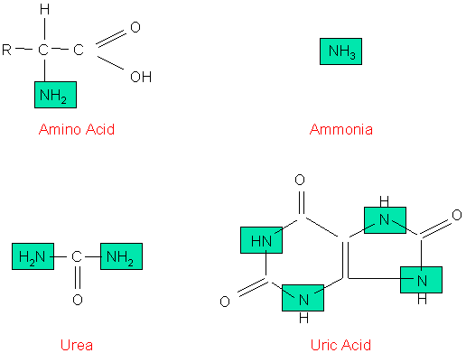
Deamination = removal of amino groups from protein molecules.
From: http://www.rlc.dcccd.edu/mathsci/reynolds/micro/lab_manual/AA.jpg
From: http://faculty.clintoncc.suny.edu/faculty/Michael.Gregory/files/Bio%20102/Bio%20102%20lectures/excretory%20system/excret1.gif

Slide 12
5. Synthesis: the process in which small simple material is combined to make large complex material.
  Ex: Photosynthesis – when plants and algae make glucose (sugar) from carbon dioxide and water).
Synthesis is necessary for growth.
6. Growth: the process in which an organism increases in size.
This is accomplished by:
increasing the volume of a cell as with unicellular organisms or by,
increasing the number of cells within an organisms by cell division (mitosis) as with multicellular organisms.

Slide 13
7. Regulation: the coordination and control of the essential metabolic functions to help maintain homeostasis (internal stability).
In multicellular organisms, regulation is accomplished by the nervous and endocrine systems.
Ex: sweating and shivering in thermoregulation.

Slide 14
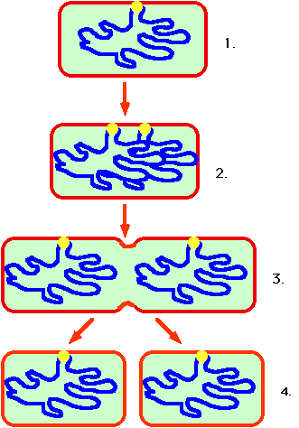
8. Reproduction: the process in which organisms produce more of their own species.
      Reproduction is not necessary for the survival of the individual, but is necessary for the survival of the species.
      Types of reproduction includes asexual (one parent) which occurs in simple organisms, and sexual reproduction (two parents) which usually occurs in complex organisms.
Asexual Reproduction in bacteria

Slide 15
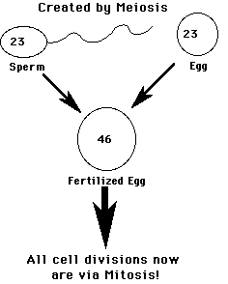
Sexual Reproduction

Slide 16
c) Why can life exist on Earth?
According to scientific estimations, the Earth is 4.5 billion years old. Life on Earth has existed for 3.5 – 3.8 billion years.
Humans (Homo sapiens) have existed on Earth for 2-3 million years.
Earth is the only place that we know that life exists.

Slide 17
d) Life can exist on Earth for several reasons
The Earth atmosphere is filled with oxygen (O2). This represents 21% of all atmospheric gases.
Water exists in vast quantities.
Our temperature on earth is moderate, not extreme.
4. The Earth has a protective ozone layer that shields life from the sun’s harmful rays (i.e.: ultraviolet radiation).
5. Earth is supplied with a constant supply of energy.
6. Carbon dioxide is fixed by autotrophs to synthesize organic molecules.

